Slide 1
Exam 1 Review

Slide 2
Exam 1
March 31, 2023
In class: 4.15 – 6.15PM
In-person, in-class
Designated Seats
Closed book, closed notes, Closed Neighbor

Slide 3
Reading material and topics
Chapter 1, 2,3, + modifiers
But it swill be helpful to review all the material we have covered so far.
Class notes
Solidity Read the Docs
Design diagrams
Topics:
Blockchain concepts
Problem solving : write a SC
Problem solving: write and use modifiers
4. Problem solving: design representation: use case, contract diagram, state diagram

Slide 4
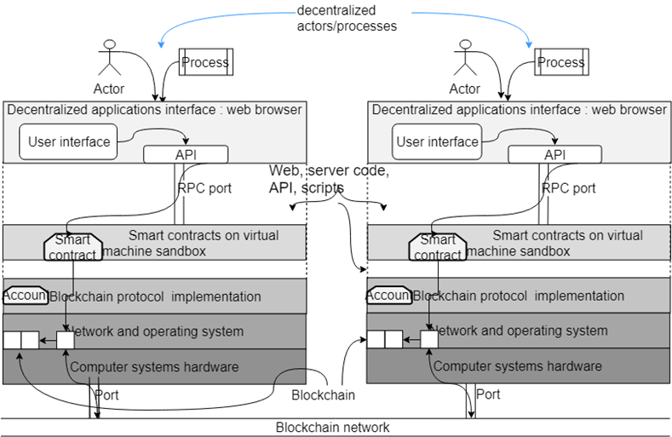
1. Blockchain structure: Dapp stack model
The blockchain concepts we learned!

Slide 5
2. Writing an SC
Basic structure of SC
Uint, struct, array, mapping, address data types
Functions syntax ( msg.sender, msg.value etc., simple arithmetic)
Simple if statement, for loop
No modifiers in this question
View function, public function, use of payable

Slide 6
3. Write and use modifiers, require etc.
Define a modifier
Modifier with messages
Use a modifier
Example from Counter.sol
modifier checkIfGreaterThanZero(uint n){
require(value >= n, 'Counter can not become negative.');
_;
}
Usage:
function decrement (uint n) public checkIfGreaterThanZero(n) {
value = value - n;
}

Slide 7
4. Design representations: UML diagrams
Use case diagram : plan, requirements
Contract diagram : static design
State diagram : captures dynamics
See Appendix A

Slide 8
Exam Format
Paper and pen/pencil exam
Closed book
No definitions, no essays
Be precise, use figures and pseudo code when answering
4 questions with subsections
20+- 5 points each

Slide 9
Time and Date
March 31, 2023, 4.15PM -6.15 PM
Be there on time
Designated seating

Slide 10
Before the exam
PREPARE
STUDY
GROUP STUDY
Focus on the items covered in the lectures.

Slide 11
On the exam day
Be there on time
Please go to the bathroom/restroom before the exam to make the best use of the exam time allocated.
Be ready with your row number
Bring pencils / pen/ eraser and other material
No phones, no calculators, no laptops , no papers allowed
When you are taking the exam, if you have any questions rise your hand
If you make some assumptions, please write it down on exam sheet
After you finish, hand the paper over to a TA and leave

Slide 12
After the exam
Leave the room quietly after submitting the paper
Do not make noise by discussing the paper outside the classroom
Wait till the grading is done to discuss any issues

